Slide 1
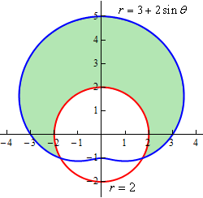
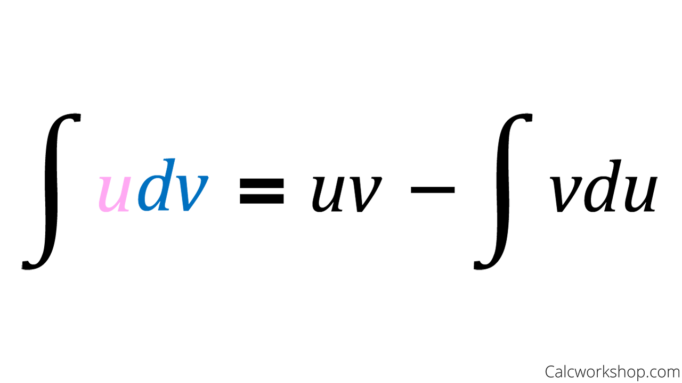
MATH 242
Analytic Geometry and Calculus B
Section 12
Instructor: Jacob Wyngaard
Introduction

Slide 2
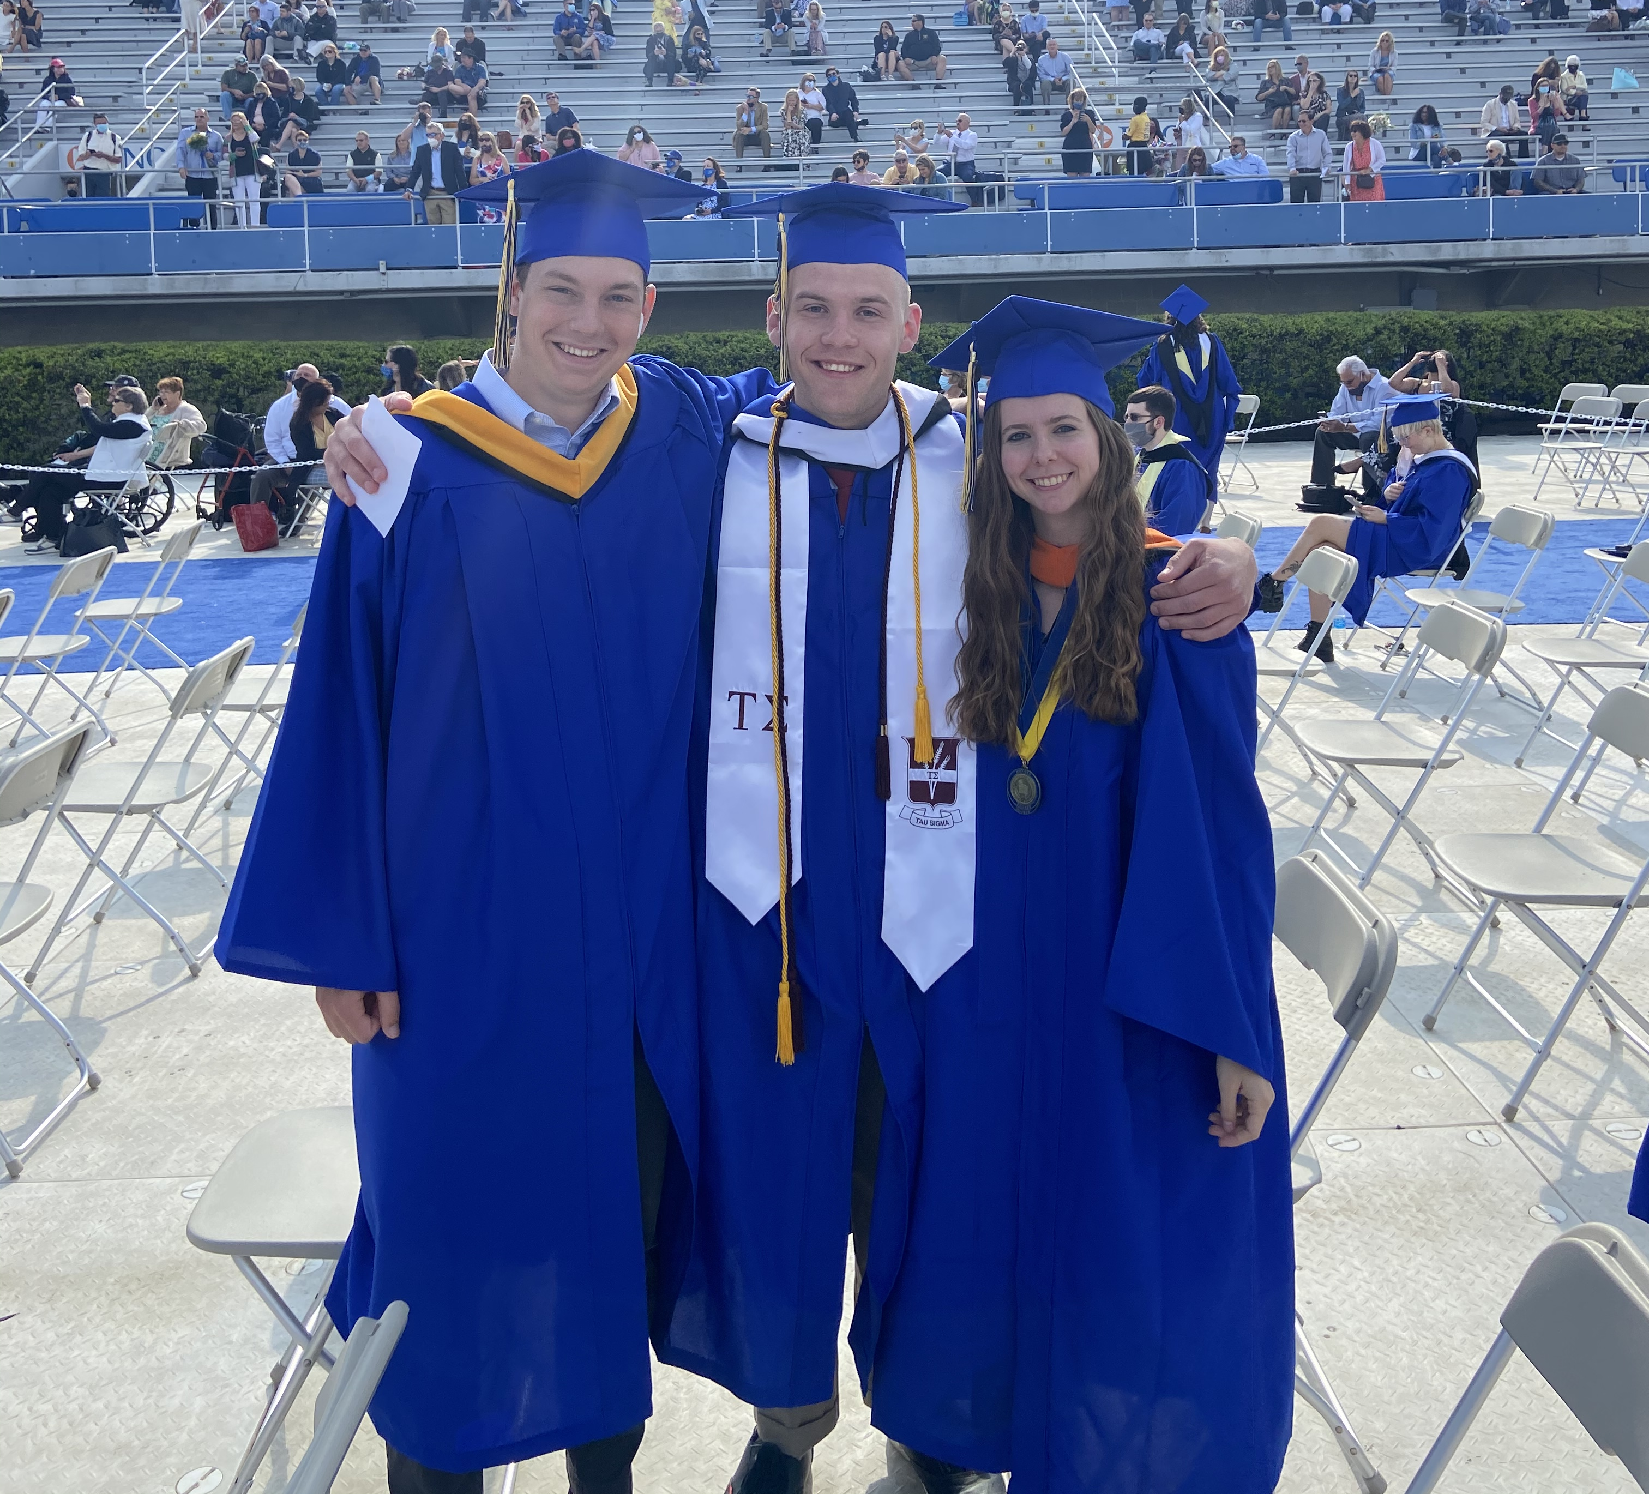

Personal Introduction
My name is Jacob Wyngaard. I’m an Applied Mathematics PhD student here at UD!
I actually graduated from UD back in 2021
I’ve since gotten a masters in physics and worked at the Johns Hopkins Applied Physics Lab building and analyzing missile defense simulations
I’ve returned to grad school to study mean field game theory with respect to prediction markets

Slide 3
Introduction Survey
I’ve posted an ungraded survey on Canvas
It’s four questions designed to help me understand the background of this class and what you want to get out of it
Insert picture of module here

Slide 4
What is MATH 242?
From the UD Course Catalog:
MATH 242: Analytic Geometry and Calculus B Brief review of MATH 241; applications of integration; integration techniques; parametric curves; polar coordinates; infinite sequences and series. Includes use of computers to perform symbolic, numerical and graphical analysis General Education Objectives: GE5A: Reason Quantitatively GE5B: Reason Computationally GE5C: Reason Scientifically
To paraphrase, MATH 242 is meant to build upon your mathematical foundation for a successful career in science and engineering

Slide 5
Course Syllabus
Add Syllabus Slides here in the pdf

Slide 6

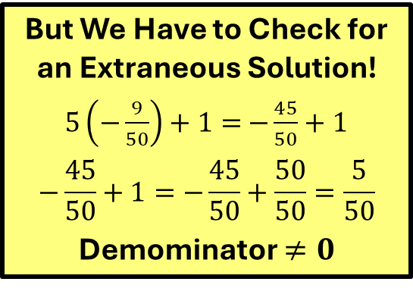
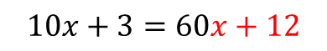
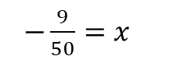


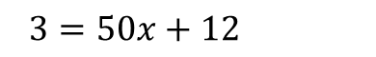
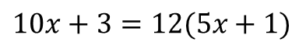
Extraneous Solutions
If there are fractions in the equation, first clear the fractions by multiplying each term by the LCD (Least Common Denominator). At the end, you need to be sure that the solution does not make the denominator equal to zero. If it does, you must discard it! These types of solutions are called extraneous solutions – they do not satisfy the original equation and therefore must be discarded.
$$\frac{10x+3}{5x+1}=12$$
But We Have to Check for an Extraneous Solution!
$5\left(−\frac{9}{50}\right)+1=$ $−\frac{45}{50}+1$
$$−\frac{45}{50}+1=−\frac{45}{50}+\frac{50}{50}=\frac{5}{50}$$
Demominator $≠0$
(5x+1) (5x+1)
$$10x+3=12(5x+1)$$
$$10x+3=60x+12$$
-10x -10x
$3=50x+12$
-12 -12
$−9=50x$
50 50
This is a conditional equation which holds for x = -.18
$−\frac{9}{50}=x$

